Slide 1
HTML INPUT TYPES
Prepared by ,
J. Elvia Camille &
Vigneswari NV

Slide 2
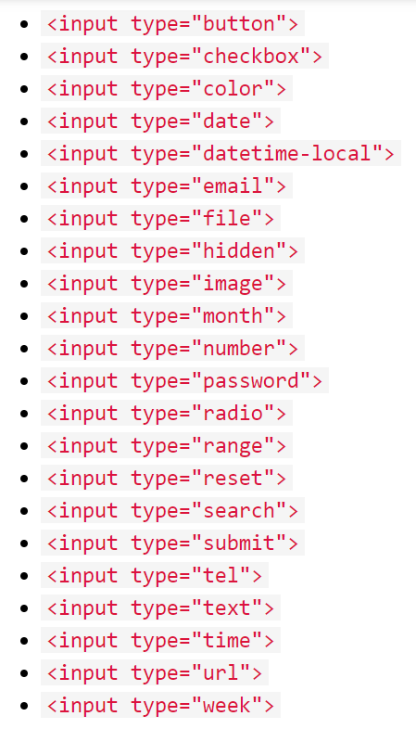
Types

Slide 3
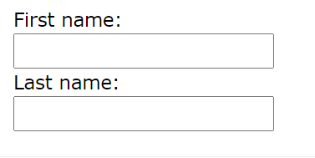
Input Type Text
It defines a single-line text input field .
Example :
<form> <label for="fname">First name:</label><br> <input type="text" id="fname" name="fname"><br> <label for="lname">Last name:</label><br> <input type="text" id="lname" name="lname"> </form>

Slide 4
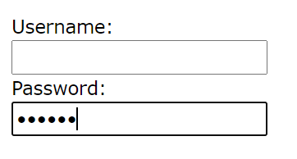
Input Type Password
It defines a password field.
The characters in a password field are masked (shown as asterisks or circles).
Example :
<form> <label for="username">Username:</label><br> <input type="text" id="username" name="username"><br> <label for="pwd">Password:</label><br> <input type="password" id="pwd" name="pwd"> </form>

Slide 5
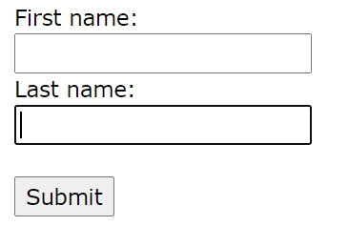
Input Type Submit
It defines a button for submitting form data to a form-handler.
If you click "Submit", the form-data will be sent to a page called "/action_page.php".
Example :
<form action="/action_page.php"> <label for="fname">First name:</label><br> <input type="text" id="fname" name="fname"=""><br> <input type="submit" value="Submit"> </form>

Slide 6
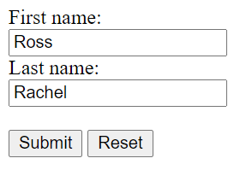
Input Type Reset
It defines a reset button that will reset all form values to their default values .
If you change the input values and then click the "Reset" button, the form-data will be reset to the default value.
Example :
<label for="fname">First name:</label><br> <input type="text" id="fname" value=“Ross"><br> <label for="lname">Last name:</label><br> <input type="text" id="lname" value=“Rachel"><br><br> <input type="submit" value="Submit"> <input type="reset">

Slide 7
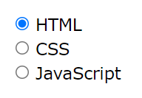
Input Type Radio
It defines a radio button.
Radio buttons let a user select ONLY ONE of a limited number of choices.
Example :
<form> <input type="radio" id="html" name="fav_language"
value="HTML"> <label for="html">HTML</label><br> <input type="radio" id="css" name="fav_language"
value="CSS"> <label for="css">CSS</label><br> <input type="radio" id="javascript" name="fav_language" value="JavaScript"> <label for="javascript">JavaScript</label> </form>

Slide 8
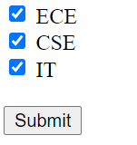
Input Type Checkbox
It defines a checkbox.
Checkboxes let a user select ZERO or MORE options of a limited number of choices.
<form> <input type="checkbox" id=“dep1" name=“dep1" value=“ECE"> <label for=“dep1"> ECE</label><br> <input type="checkbox" id=“dep2" name=“dep2" value=“CSE"> <label for=“dep2"> CSE</label><br> <input type="checkbox" id=“dep3" name=“dep3" value=“IT"> <label for=“dep3"> IT</label> </form>

Slide 9

Input Type Button
It defines a button.
HTML Button tag can be used inside and outside the form.
Example :
<input type="button" onclick="alert('Hello World!')" value="Click Me!">

Slide 10
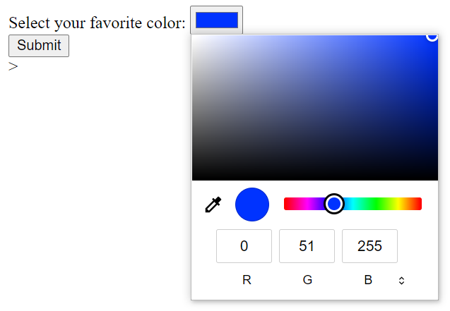
Input Type Color
It is used for input fields that should contain a color.
Depending on browser support, a color picker can show up in the input field.
Example :
<form> <label for="favcolor">Select your favorite color:</label> <input type="color" id="favcolor"
name="favcolor"> </form>

Slide 11

Input Type Date
It is used for input fields that should contain a date.
Example :
<form> <label for="birthday">Birthday:</label> <input type="date" id="birthday" name="birthday"> </form>

Slide 12
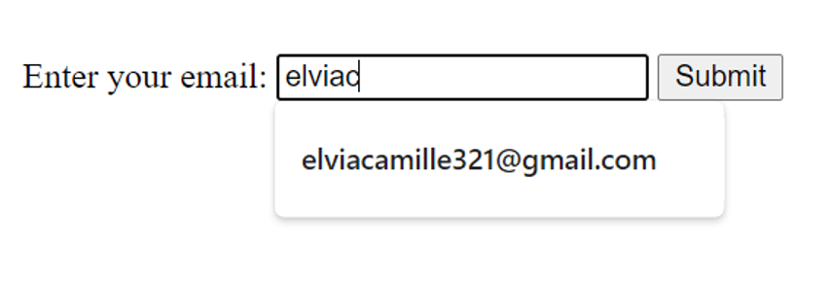
Input Type Email
It is used for input fields that should contain an e-mail address.
Some smartphones recognize the email type and adds ".com" to the keyboard to match email input.
Example :
<form> <label for="email">Enter your email:</label> <input type="email" id="email" name="email"> </form>

Slide 13
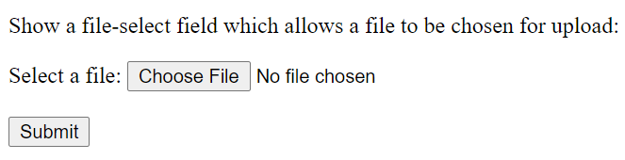
Input Type File
It defines a file-select field and a "Browse" button for file uploads.
Example :
<form> <label for="myfile">Select a file:</label> <input type="file" id="myfile" name="myfile"> </form>

Slide 14
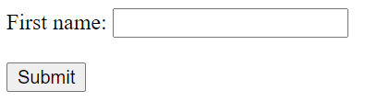
Input Type Hidden
It defines a hidden input field (not visible to a user).
A hidden field let web developers include data that cannot be seen or modified by users when a form is submitted.
A hidden field often stores what database record that needs to be updated when the form is submitted.
Example :
<label for="fname">First name:</label> <input type="text" id="fname" name="fname"><br><br> <input type="hidden" id="custId" name="custId" value="3487"> <input type="submit" value="Submit">

Slide 15
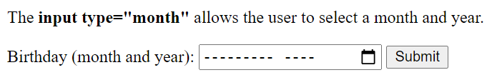
Input Type Month
It allows the user to select a month and year.
Depending on browser support, a date picker can show up in the input field.
Example :
<form> <label for="bdaymonth">Birthday (month and year):</label> <input type="month" id="bdaymonth" name="bdaymonth"> </form>

Slide 16

Input Type Number
It defines a numeric input field.
We can also set restrictions on what numbers are accepted.
We can use the min and max attributes to add numeric restrictions in the input field
The following example displays a numeric input field, where you can enter a value from 1 to 5 :
<form> <label for="quantity">Quantity (between 1 and 5):</label> <input type="number" id="quantity" name="quantity" min="1" max="5"> </form>

Slide 17

Input Type Range
It defines a control for entering a number whose exact value is not important (like a slider control).
Default range is 0 to 100. However, we can set restrictions on what numbers are accepted with the min, max, and step attributes.
Example :
<form> <label for="vol">Volume (between 0 and 50):</label> <input type="range" id="vol" name="vol" min="0" max="50"> </form>

Slide 18

Input Type Search
It is used for search fields (a search field behaves like a regular text field).
Example :
<form> <label for="gsearch">Search Google:</label> <input type="search" id="gsearch" name="gsearch"> </form>

Slide 19
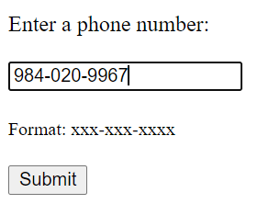
Input Type Tel
It is used for input fields that should contain a telephone number.
Example :
<form> <label for="phone">Enter your phone number:</label> <input type="tel" id="phone" name="phone" pattern="[0-9]{3}-[0-9]{3}-[0-9]{4}"> </form>

Slide 20
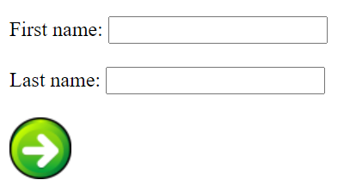
Input type Image
Define an image as a submit button .
Example :
<input type="image" src="img_submit.gif" alt="Submit" width="48" height="48">

Slide 21
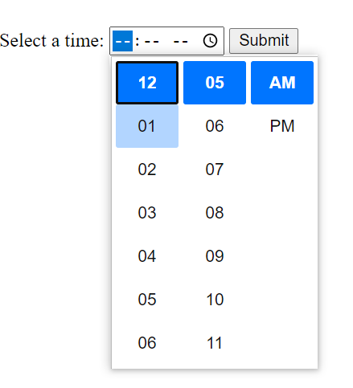
Input Type Time
It allows the user to select a time (no time zone).
If the browser supports it, a time picker
pops up when entering the input field.
Example :
<form> <label for="appt">Select a time:</label> <input type="time" id="appt" name="appt"> </form>

Slide 22

Input Type Url
It is used for input fields that should contain a URL address.
Depending on browser support, the url field can be automatically Validated when submitted.
Some smartphones recognize the url type, and adds ".com" to the keyboard to match url input.
Example :
<form> <label for="homepage">Add your homepage:</label> <input type="url" id="homepage" name="homepage"> </form>

Slide 23
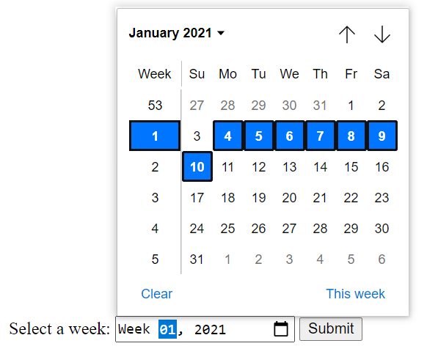
Input Type Week
It allows the user to select a week and year.
Depending on browser support, a date picker
can show up in the input field.
Example :
<form> <label for="week">Select a week:</label> <input type="week" id="week" name="week"> </form>

Slide 24

Input Type Date-time local
It allows the user to select the year,month,day and time.
Example:
<label for="birthdaytime">Birthday :</label>
<input type="datetime-local" id="birthdaytime" name="birthdaytime">

Slide 25
HTML Input Attributes
Value
Readonly
Disabled
Multiple
Pattern
Placeholder
Required
Step
Autofocus
List
Autocomplete

Slide 26

Input Attribute Value:
The value attribute provides a default value in the space which acts as the initial value
Example:
<label for="fname">First name:</label><br>
<input type="text" id="fname" name="fname" value="Vikky"><br>
<label for="lname">Last name:</label><br>
<input type="text" id="lname" name="lname" value="Vikky"><br><br>

Slide 27

Input Attribute Readonly:
The readonly attribute sets the input value with a constant.
It cannot be changed or modified. It will get submitted as the same when the form gets submitted.
Example:
<label for="fname">First name:</label><br>
<input type="text" id="fname" name="fname" value="vikky" readonly><br>

Slide 28

Input Attribute Disabled:
The input field becomes unusable and unclickable.
The value will not be submitted on submitting the form.
Example:
<label for="fname">First name:</label><br>
<input type="text" id="fname" name="fname" value="vikky" disabled><br>
<label for="lname">Last name:</label><br>
<input type="text" id="lname" name="lname">

Slide 29
Input Attribute multiple:
It allows to add more than one value.
This attribute can be used when an input field requires multiple file submission.
Example:
<input type="file" id="files" name="files" multiple><br><br>

Slide 30
Input Attribute pattern:
Pattern attribute provides a regular expression that the input field must follow.
This could be used for email and address.
Example:
<input type="text" id="country_code" name="country_code"
pattern="[A-Za-z]{3}">

Slide 31

Input Attribute placeholder:
Placeholders act as a hint for the users. They act as a sample value but just for the understanding of the user. They cannot be submitted on submitting the form.
Example:
<input type="tel" id="phone" name="phone"
placeholder="123-45-678"
pattern="[0-9]{3}-[0-9]{2}-[0-9]{3}">
<input type="email" id="mail" name="mail"
placeholder="Enter your mail id">

Slide 32
Input Attribute required:
The input value must be filled before submitting the form.
It will throw an error if submitted without value.
Example:
<input type="text" id="username" name="username" required>

Slide 33


Input Attribute step:
The step attribute determines the intervals between the value that can be entered.
Increasing or decreasing the range will happen based on the interval.
Example:
<input type="number" id="points" name="points" step="3">

Slide 34

Input Attribute autofocus:
It lets a particular input filed to be focused at first whenever the page loads.
It marks the beginning to the user.
Example:
<label for="fname">First name:</label><br>
<input type="text" id="fname" name="fname" autofocus><br>
<label for="lname">Last name:</label><br>
<input type="text" id="lname" name="lname">

Slide 35
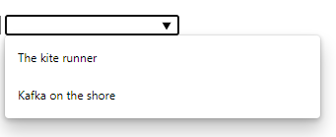
Input Attribute list:
The list attribute acts as the interconnection between the datalist and input column.
Example:
<input list="books">
<datalist id="books">
<option value="The kite runner">
<option value="Kafka on the shore">
</datalist>

Slide 36
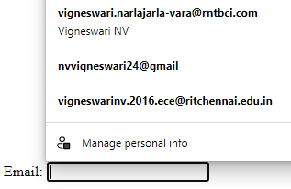
Input Attribute autocomplete:
It determines if a form input should have autocomplete on or off.
If the autocomplete is “on”, the input column will get suggested with the values that has been recorded before by the user.
Example:
<label for="email">Email:</label>
<input type="email" id="email" name="email" autocomplete="on"><br><br>

Slide 37

Input Attribute size and minmax:
The input size attribute specifies the length of the characters in the input field.
Example:
<label for="pin2">PIN</label><br>
<input id="pin2" name="pin2" size="4" maxlength="4"><br>

